Slide 1
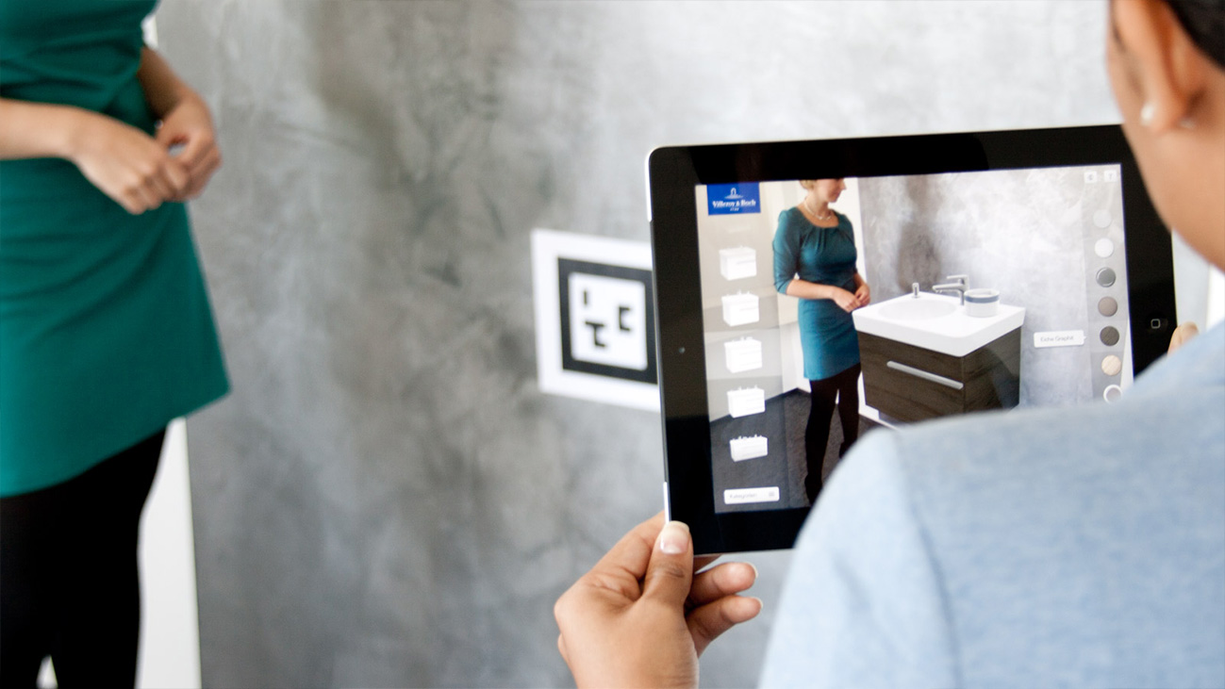
Augmented Reality
Daniel Daugherty, Kevin Guo, Cedric Kim, Kevin Zhang

Slide 2
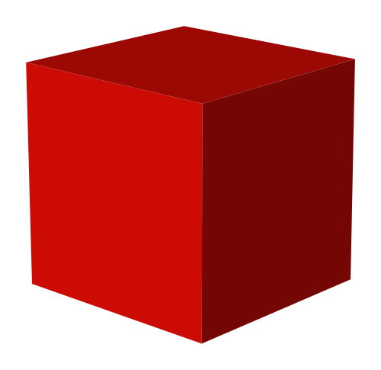
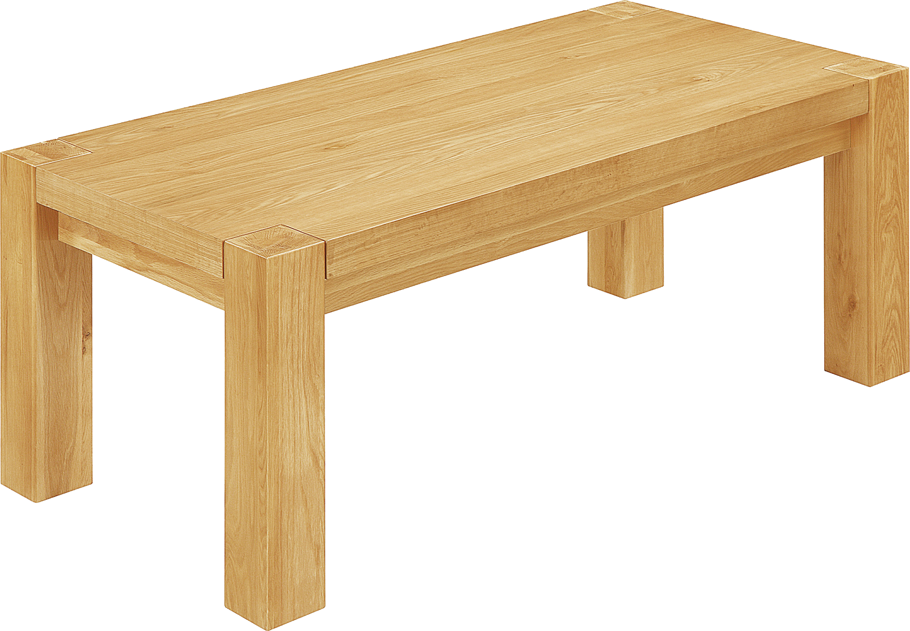
Project Overview - VR Object Viewing
The Core of the Project:
Tracking Post-it (OpenCV)
Perspective analysis
Model overlay (Cube, CAD)
Stereoscopy effect
VR Experience
The Stretch Goals:
Interaction
Networking

Slide 3
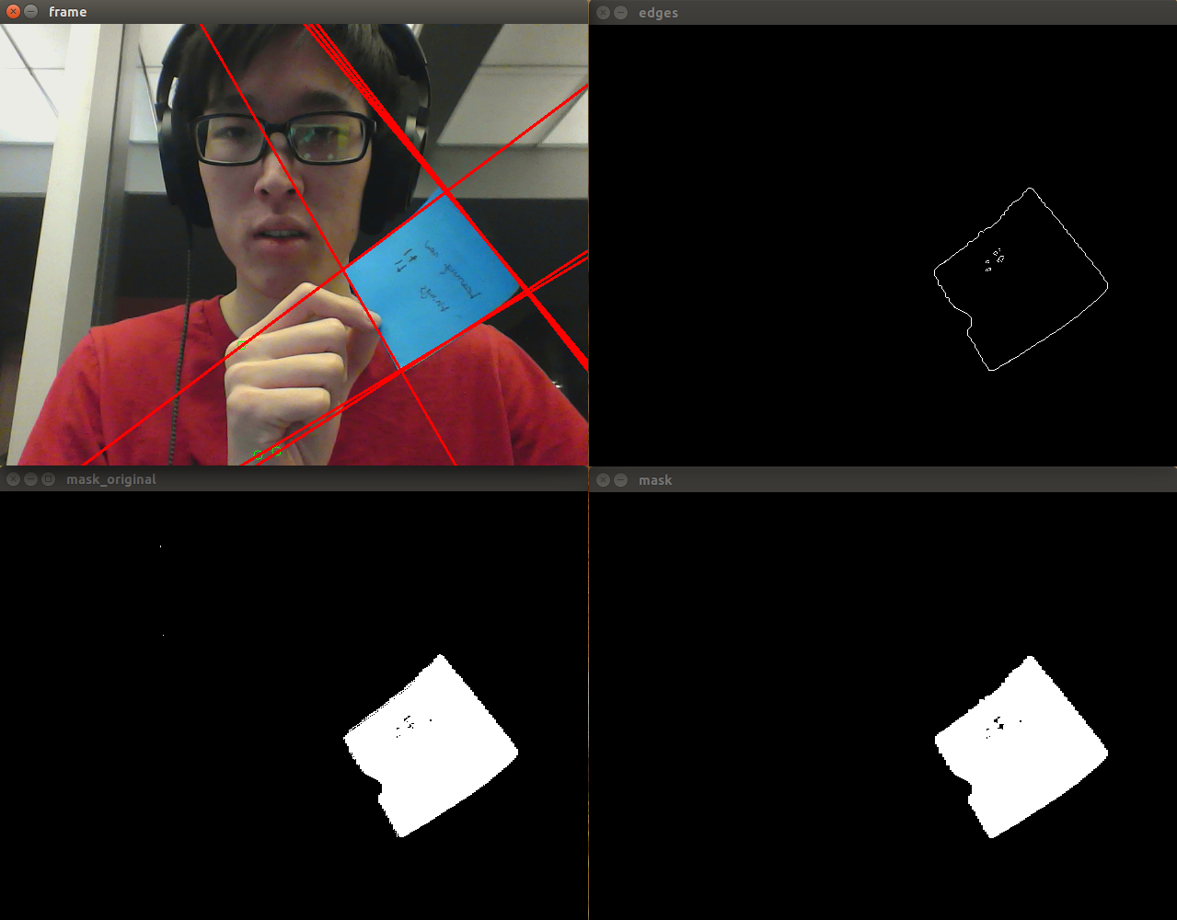
Sticky Note Demo
Mask
Canny Lines
Hough Lines/Contour

Slide 4
Our Questions
Lighting conditions
Locating corners of a quadrilateral
HoughLines (multiple lines)
Cad model implementation
OpenGL

Slide 5
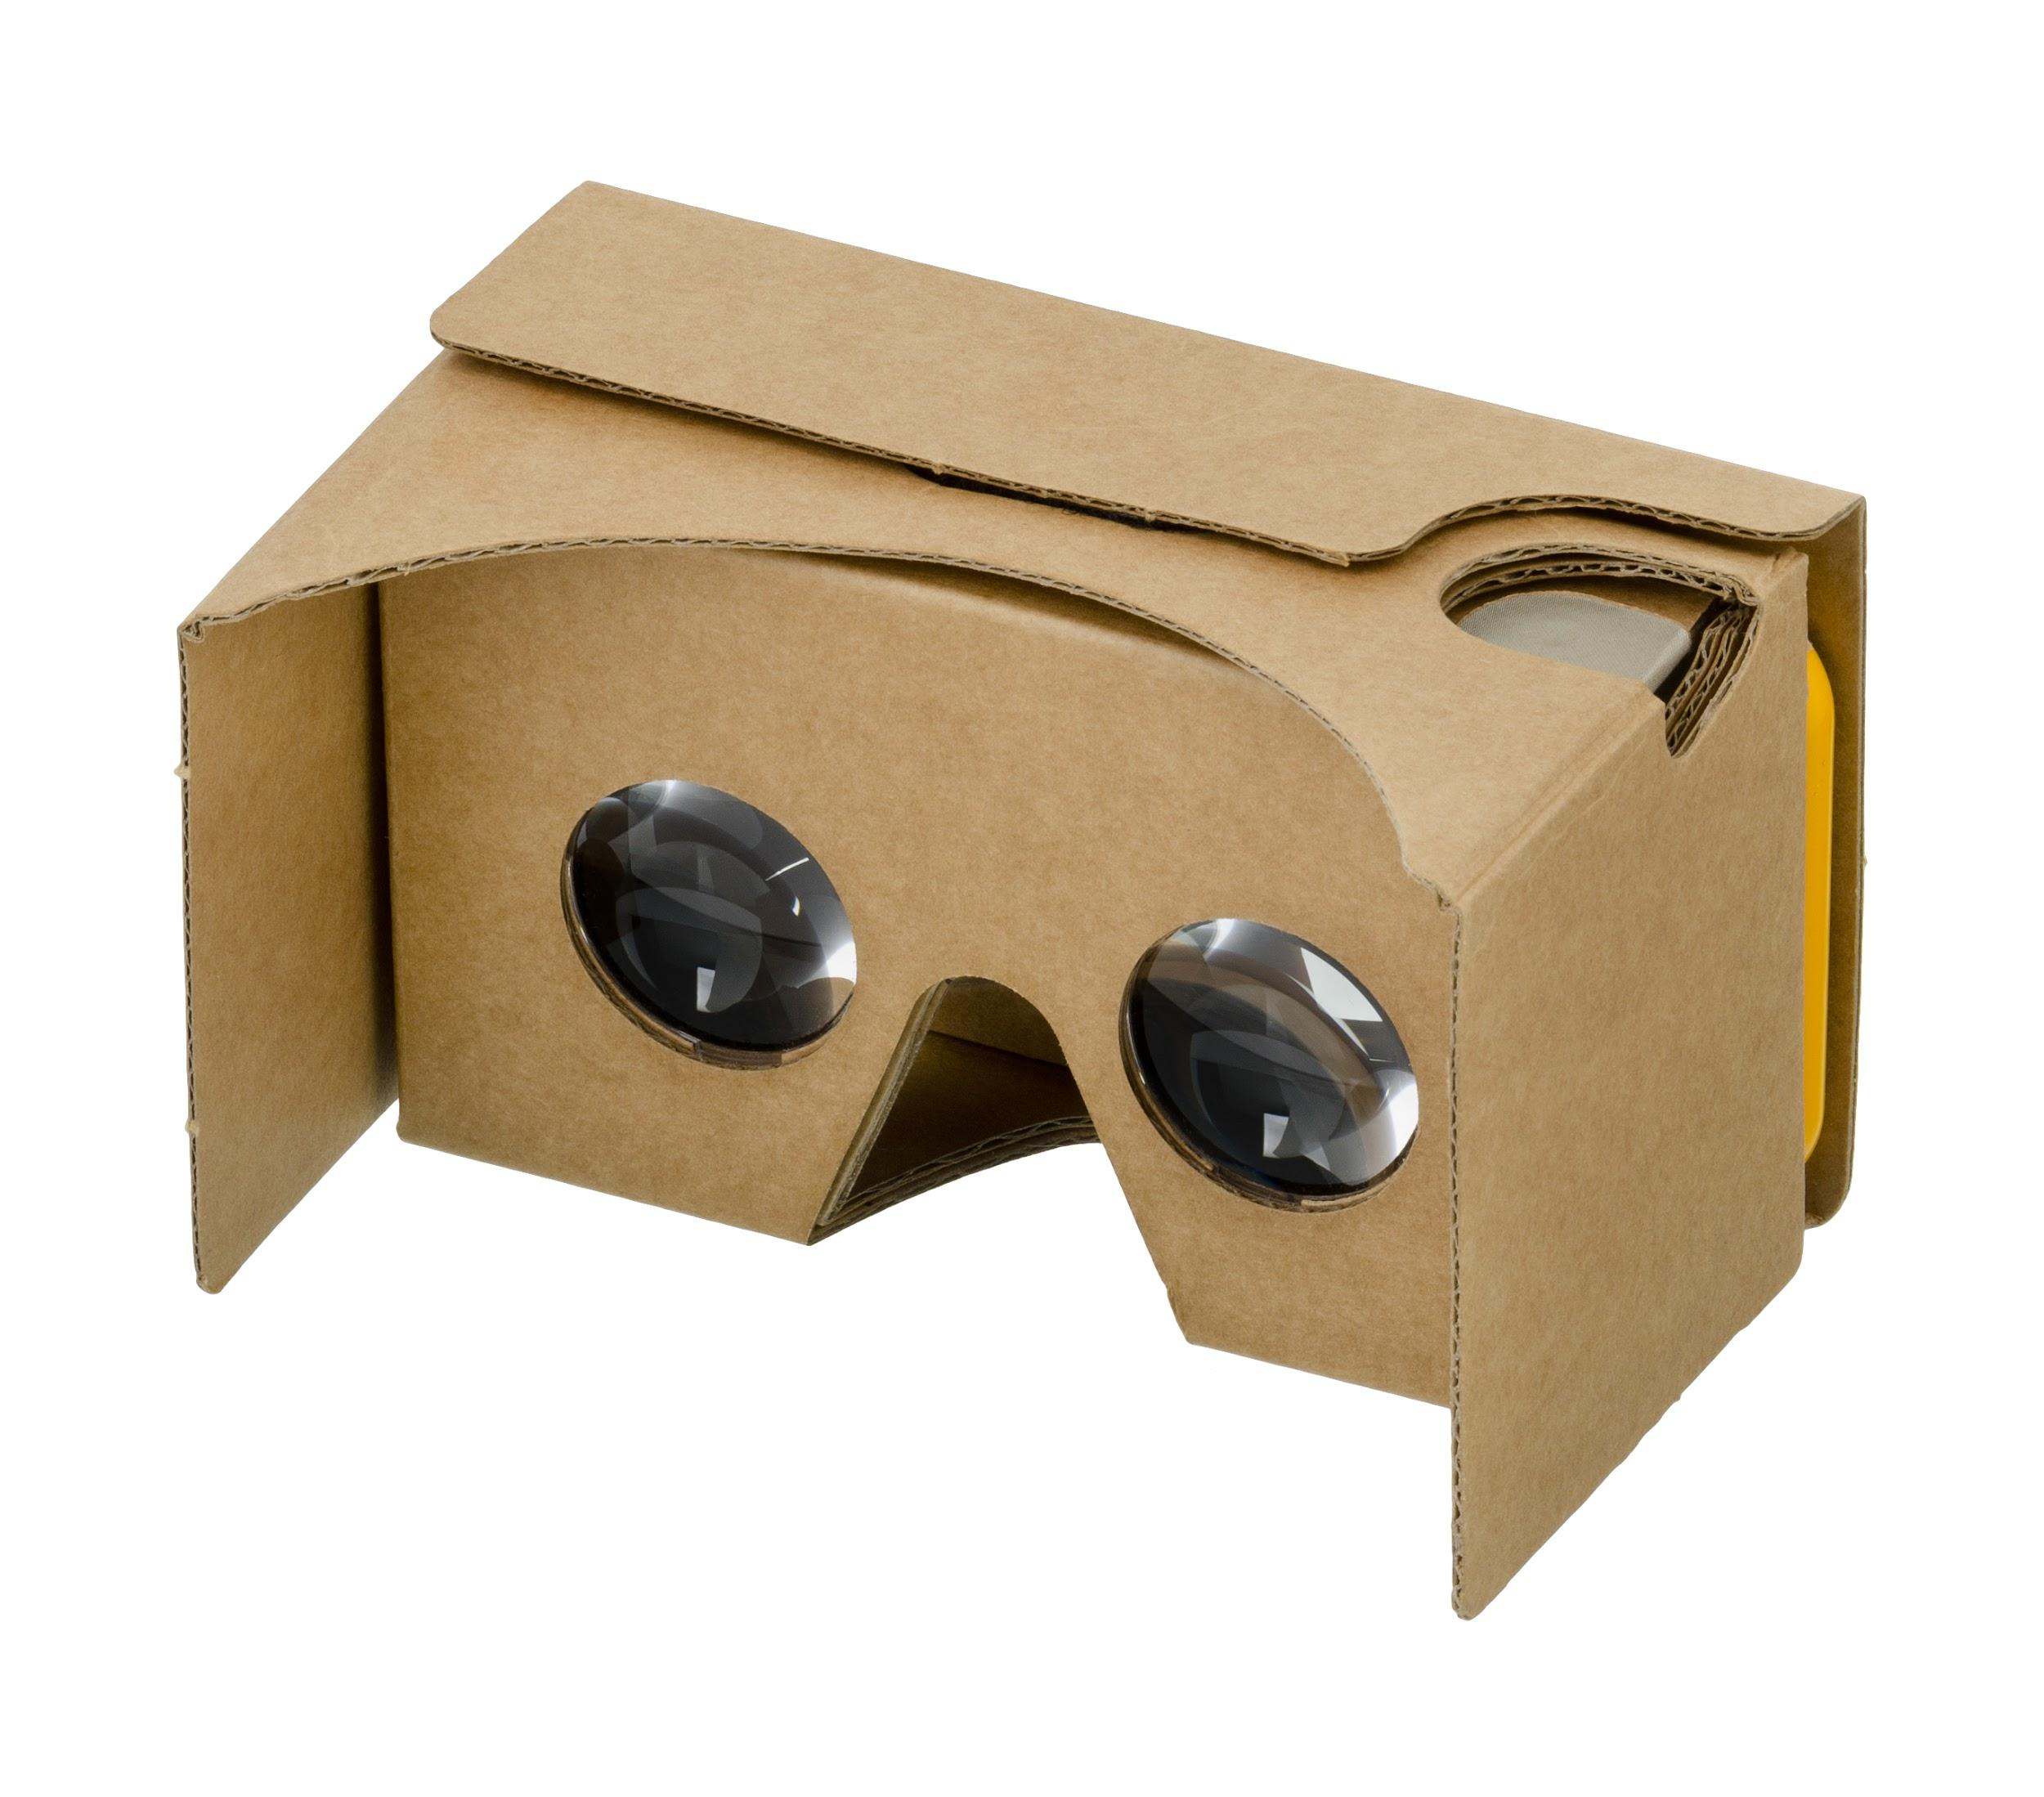
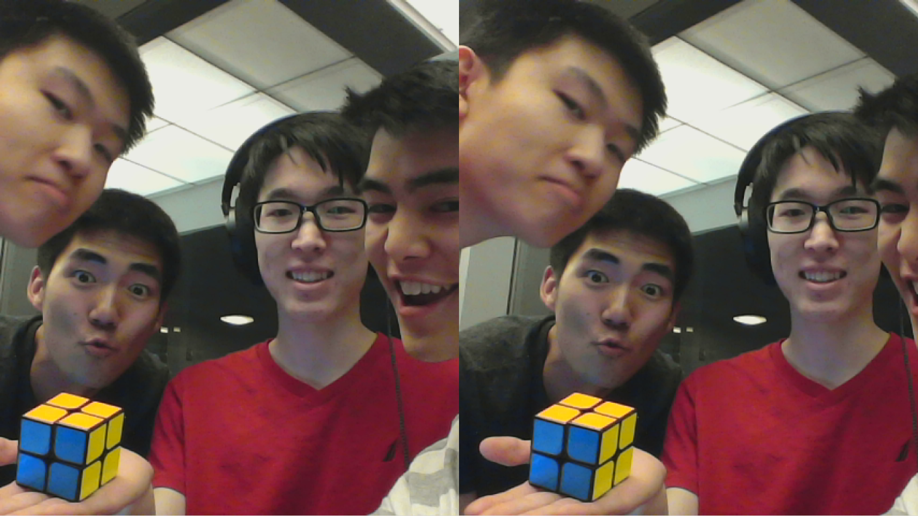
Google Cardboard Viewer Demo
Created Google Cardboard camera format in OpenCV
VNC viewer
Lack of Stereoscopy
Laggy and battery probs
Basis of our work:
LINK

Slide 6
Our Questions...
Better method to link PC camera to phone
Stereoscopy Effect
Suggestions for the image?
Offset between the eyes?
Centered?
Code Structure?

Slide 7
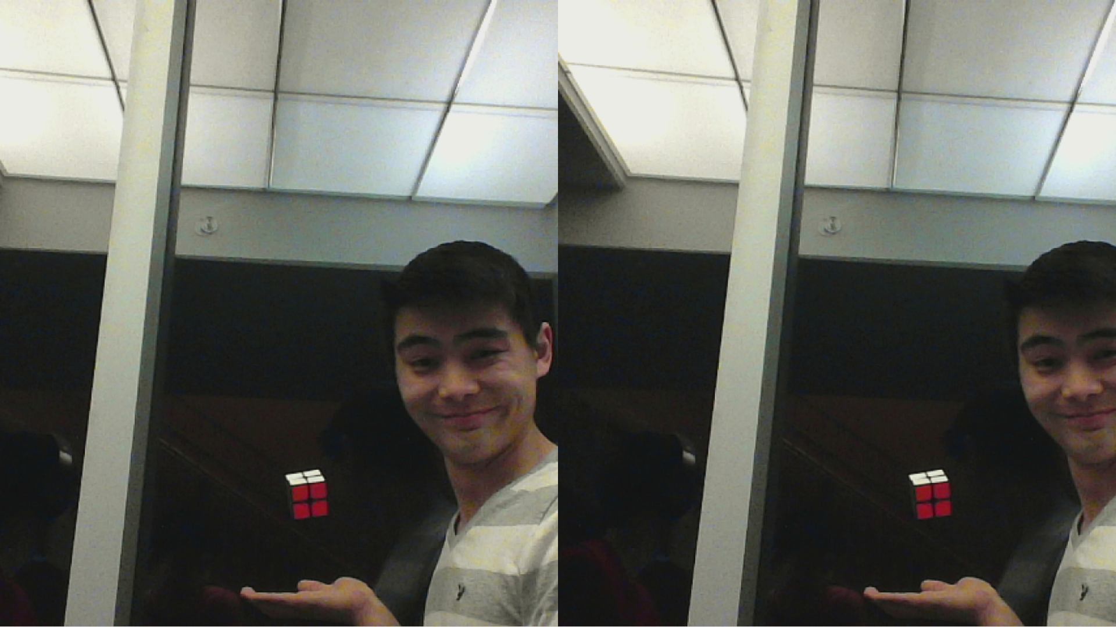
Additional Comments or Questions?

